Slide 1
Java Persistence API and Hibernate
Marcel Costa
Paulo Panini
marcel.costa@wipro.com
paulo.panini@wipro.com
Notes:
The below and following notes on the template slides are to guide you only. In your final presentation, you may delete these notes and add relevant notes if any.
Title slide:
Title – should not exceed beyond 3 lines, font size 30-34, Arial Bold
(Font size for the title of the PPT can vary between 30-34, Arial, Bold depending on the amount of text, however should not be smaller than 30 font size)
Name should not exceed beyond 1 line, Designation; font size to remain at 16, Arial normal
Please keep the title slide simple, just the logo, title and name and designation to appear. No other graphic elements or any design, photograph, image can be added to this slide, alignment to remain the same

Slide 2
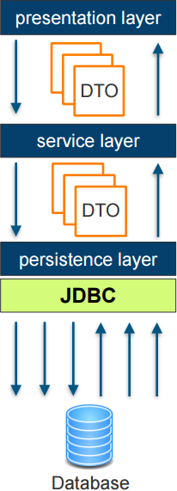
Motivation
Tradidional persistence with JDBC
Notes:
Content Slide: This is usually the most frequently used slide in every presentation.
Use this slide for Text heavy slides. Text can only be used in bullet points
Title Heading – font size 30, Arial bold
Slide Content – Should not reduce beyond Arial font 16
If you need to use sub bullets please use the indent buttons located next to the bullets buttons in the tool bar and this will automatically provide you with the second, third, fourth & fifth level bullet styles and font sizes
Please note you can also press the tab key to create the different levels of bulleted content

Slide 3
Motivation
JDBC – Java Database Connectivity
Used to access relational databases from Java programs
First version released 1996
Ability to
Establish a connection to a database
Execute an SQL statement and return results
Create parameterized queries
Manage database transactions
Basic Steps
Load driver or obtain an already defined data source
Establish connection using a JDBC URL
Create an SQL statement and execute SQL statement
If present, process results present in result sets
Close database resources
Commit or rollback transaction, if necessary
Notes:
Content Slide: This is usually the most frequently used slide in every presentation.
Use this slide for Text heavy slides. Text can only be used in bullet points
Title Heading – font size 30, Arial bold
Slide Content – Should not reduce beyond Arial font 16
If you need to use sub bullets please use the indent buttons located next to the bullets buttons in the tool bar and this will automatically provide you with the second, third, fourth & fifth level bullet styles and font sizes
Please note you can also press the tab key to create the different levels of bulleted content

Slide 4
JDBC example
Find all rows from a table with name equals to a given string
Notes:
Section breaker slide:
Used for a section heading. You may add a sub heading not exceeding one line also here
Section heading – Arial, bold, 34 font size, should not exceed beyond 1 line
Sub Head – Arial, normal, 20 font size, should not exceed beyond 1 line

Slide 5
JDBC
Drawbacks
Verbose JDBC boilerplate code for the various CRUD actions
Manual mapping of JDBC result sets to the respective Java POJOs
Imagine 40 different database tables with 20 attributes each…
Manual synchronization of Java code in case of database schema changes (e.g., a new field is added to a database table)
Manual adaptation of the entire related JDBC Java code necessary
Notes:
Content Slide: This is usually the most frequently used slide in every presentation.
Use this slide for Text heavy slides. Text can only be used in bullet points
Title Heading – font size 30, Arial bold
Slide Content – Should not reduce beyond Arial font 16
If you need to use sub bullets please use the indent buttons located next to the bullets buttons in the tool bar and this will automatically provide you with the second, third, fourth & fifth level bullet styles and font sizes
Please note you can also press the tab key to create the different levels of bulleted content

Slide 6
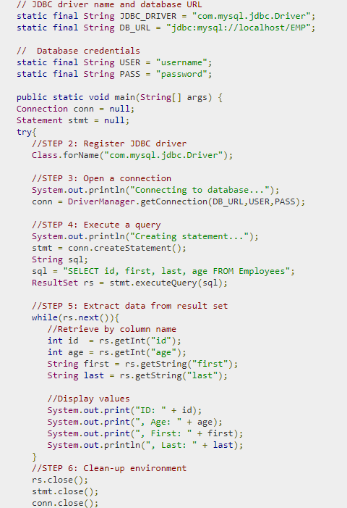
JDBC
Example
Notes:
Content Slide: This is usually the most frequently used slide in every presentation.
Use this slide for Text heavy slides. Text can only be used in bullet points
Title Heading – font size 30, Arial bold
Slide Content – Should not reduce beyond Arial font 16
If you need to use sub bullets please use the indent buttons located next to the bullets buttons in the tool bar and this will automatically provide you with the second, third, fourth & fifth level bullet styles and font sizes
Please note you can also press the tab key to create the different levels of bulleted content

Slide 7
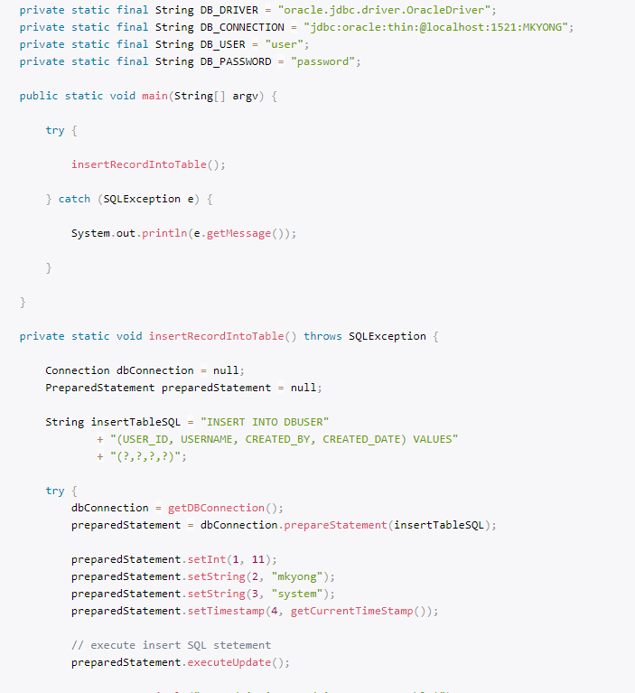
JDBC
Example https://www.mkyong.com/jdbc/jdbc-preparestatement-example-insert-a-record/
Notes:
Content Slide: This is usually the most frequently used slide in every presentation.
Use this slide for Text heavy slides. Text can only be used in bullet points
Title Heading – font size 30, Arial bold
Slide Content – Should not reduce beyond Arial font 16
If you need to use sub bullets please use the indent buttons located next to the bullets buttons in the tool bar and this will automatically provide you with the second, third, fourth & fifth level bullet styles and font sizes
Please note you can also press the tab key to create the different levels of bulleted content

Slide 8
What is Object Relational Model?
Notes:
Section breaker slide:
Used for a section heading. You may add a sub heading not exceeding one line also here
Section heading – Arial, bold, 34 font size, should not exceed beyond 1 line
Sub Head – Arial, normal, 20 font size, should not exceed beyond 1 line

Slide 9
Motivation
Why use an Object Relational Model?
Notes:
Section breaker slide:
Used for a section heading. You may add a sub heading not exceeding one line also here
Section heading – Arial, bold, 34 font size, should not exceed beyond 1 line
Sub Head – Arial, normal, 20 font size, should not exceed beyond 1 line

Slide 10
Object Relational Mapping
Reasons for using ORM
Advantages of the OOO
Speeding development
Huge reduction in code
Rich query capability
Notes:
Content Slide: This is usually the most frequently used slide in every presentation.
Use this slide for Text heavy slides. Text can only be used in bullet points
Title Heading – font size 30, Arial bold
Slide Content – Should not reduce beyond Arial font 16
If you need to use sub bullets please use the indent buttons located next to the bullets buttons in the tool bar and this will automatically provide you with the second, third, fourth & fifth level bullet styles and font sizes
Please note you can also press the tab key to create the different levels of bulleted content

Slide 11
Java Persistence API (JPA)
Introduction
Specification for the management of persistence and object/relational mapping with Java
Objective: provide an object/relational mapping facility for Java developers using a Java domain model and a relational database
Map Java POJOs to relational databases (which are one type of persistence)
Standardized under the Java Community Process Program with contributions from Hibernate, TopLink, JDO, and the EJB community
Notes:
Content Slide: This is usually the most frequently used slide in every presentation.
Use this slide for Text heavy slides. Text can only be used in bullet points
Title Heading – font size 30, Arial bold
Slide Content – Should not reduce beyond Arial font 16
If you need to use sub bullets please use the indent buttons located next to the bullets buttons in the tool bar and this will automatically provide you with the second, third, fourth & fifth level bullet styles and font sizes
Please note you can also press the tab key to create the different levels of bulleted content

Slide 12
Java Persistence API (JPA)
Introduction
Hibernate: Full JPA implementation with additional “native” features, e.g.,
HQL (Hibernate Query Language) - similar to JPQL, but with some extensions
Criteria API
Used version in this course: Hibernate 4.3.11.Final (supports JPA 2.1)
Notes:
Content Slide: This is usually the most frequently used slide in every presentation.
Use this slide for Text heavy slides. Text can only be used in bullet points
Title Heading – font size 30, Arial bold
Slide Content – Should not reduce beyond Arial font 16
If you need to use sub bullets please use the indent buttons located next to the bullets buttons in the tool bar and this will automatically provide you with the second, third, fourth & fifth level bullet styles and font sizes
Please note you can also press the tab key to create the different levels of bulleted content

Slide 13
Understanding
ORM and JPA
With JPA/Hibernate lots of “magic” is done under the hood, e.g., SQL-DDL is automatically generated
Know the database basics first (e.g., from a data engineering course), in order to fully understand what JPA is doing under the hood
After annotating the classes and running the application check the resulting SQL-DDL (e.g., using the database explorer in IntelliJ or Eclipse)
When executing SQL-Queries using JPA/Hibernate use the “show SQL queries” feature during development, in order to see what kind of queries are actually executed
Set <property name="hibernate.show_sql" value="true" /> in persistence.xml
Notes:
Content Slide: This is usually the most frequently used slide in every presentation.
Use this slide for Text heavy slides. Text can only be used in bullet points
Title Heading – font size 30, Arial bold
Slide Content – Should not reduce beyond Arial font 16
If you need to use sub bullets please use the indent buttons located next to the bullets buttons in the tool bar and this will automatically provide you with the second, third, fourth & fifth level bullet styles and font sizes
Please note you can also press the tab key to create the different levels of bulleted content

Slide 14
Persistent Entities
Basics
They are POJOs (Plain Old Java Objects)
Lightweight persistent domain object
Typically represent a table in a relational database
Each entity instance corresponds to one row in that table
Have a persistent identity
May have both, persistent and transient (non-persistent) state
Simple types (primitive data types, wrappers, enums)
Composite types (e.g., Address)
Non-persistent state (using identifier transient or @Transient annotation)
Notes:
Content Slide: This is usually the most frequently used slide in every presentation.
Use this slide for Text heavy slides. Text can only be used in bullet points
Title Heading – font size 30, Arial bold
Slide Content – Should not reduce beyond Arial font 16
If you need to use sub bullets please use the indent buttons located next to the bullets buttons in the tool bar and this will automatically provide you with the second, third, fourth & fifth level bullet styles and font sizes
Please note you can also press the tab key to create the different levels of bulleted content

Slide 15
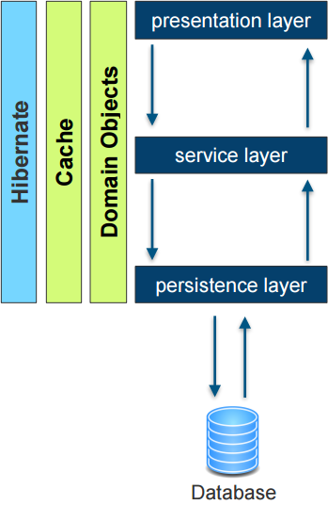
Persistence with Hibernate
Notes:
Content Slide: This is usually the most frequently used slide in every presentation.
Use this slide for Text heavy slides. Text can only be used in bullet points
Title Heading – font size 30, Arial bold
Slide Content – Should not reduce beyond Arial font 16
If you need to use sub bullets please use the indent buttons located next to the bullets buttons in the tool bar and this will automatically provide you with the second, third, fourth & fifth level bullet styles and font sizes
Please note you can also press the tab key to create the different levels of bulleted content

Slide 16
Simple Mapping
Enhance Java domain classes with JPA annotations
ExamResult
id | exam_date | mark
Important elements
@Entity | Specifies that the class is an entity
@Id | Specifies the primary key of an entity
@Column | Defines the properties for a column
@Temporal | Must be specified for fields of type java.util.Date and java.util.Calendar
@Transient | Specifies that the field is not persistent
Notes:
Content Slide: This is usually the most frequently used slide in every presentation.
Use this slide for Text heavy slides. Text can only be used in bullet points
Title Heading – font size 30, Arial bold
Slide Content – Should not reduce beyond Arial font 16
If you need to use sub bullets please use the indent buttons located next to the bullets buttons in the tool bar and this will automatically provide you with the second, third, fourth & fifth level bullet styles and font sizes
Please note you can also press the tab key to create the different levels of bulleted content

Slide 17
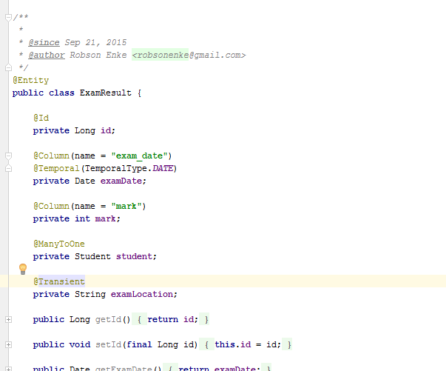
Simple Mapping
Enhance Java domain classes with JPA annotations
Notes:
Content Slide: This is usually the most frequently used slide in every presentation.
Use this slide for Text heavy slides. Text can only be used in bullet points
Title Heading – font size 30, Arial bold
Slide Content – Should not reduce beyond Arial font 16
If you need to use sub bullets please use the indent buttons located next to the bullets buttons in the tool bar and this will automatically provide you with the second, third, fourth & fifth level bullet styles and font sizes
Please note you can also press the tab key to create the different levels of bulleted content

Slide 18
Simple Mapping
Enhance Java domain classes with JPA annotations
Exercise 1
Setup the environment
git clone https://github.com/marcelsamaruga/wiproTraining.git
Persiste the object (Course.class)
Notes:
Content Slide: This is usually the most frequently used slide in every presentation.
Use this slide for Text heavy slides. Text can only be used in bullet points
Title Heading – font size 30, Arial bold
Slide Content – Should not reduce beyond Arial font 16
If you need to use sub bullets please use the indent buttons located next to the bullets buttons in the tool bar and this will automatically provide you with the second, third, fourth & fifth level bullet styles and font sizes
Please note you can also press the tab key to create the different levels of bulleted content

Slide 19
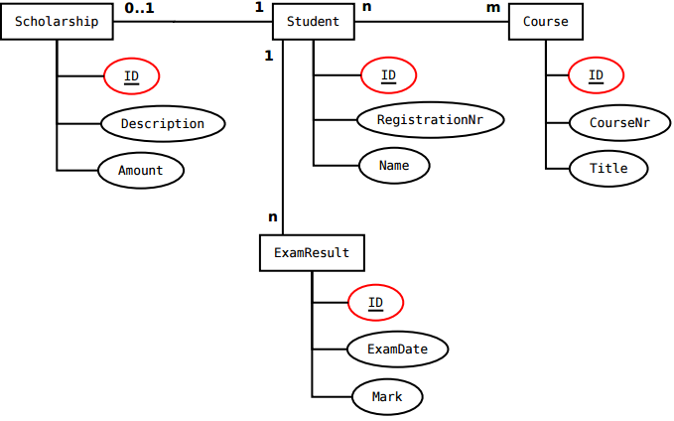
Simple Mapping
Relationship
Notes:
Content Slide: This is usually the most frequently used slide in every presentation.
Use this slide for Text heavy slides. Text can only be used in bullet points
Title Heading – font size 30, Arial bold
Slide Content – Should not reduce beyond Arial font 16
If you need to use sub bullets please use the indent buttons located next to the bullets buttons in the tool bar and this will automatically provide you with the second, third, fourth & fifth level bullet styles and font sizes
Please note you can also press the tab key to create the different levels of bulleted content

Slide 20
Simple Mapping
Inheritance
Important elements
@MappedSuperclass | Designates a class whose mapping information is applied to the entities that inherit from it. A mapped superclass has no separate table defined for it.
@GeneratedValue | The GeneratedValue annotation may be applied to a primary key property or field of an entity or mapped superclass in conjunction with the Id annotation
Notes:
Content Slide: This is usually the most frequently used slide in every presentation.
Use this slide for Text heavy slides. Text can only be used in bullet points
Title Heading – font size 30, Arial bold
Slide Content – Should not reduce beyond Arial font 16
If you need to use sub bullets please use the indent buttons located next to the bullets buttons in the tool bar and this will automatically provide you with the second, third, fourth & fifth level bullet styles and font sizes
Please note you can also press the tab key to create the different levels of bulleted content

Slide 21
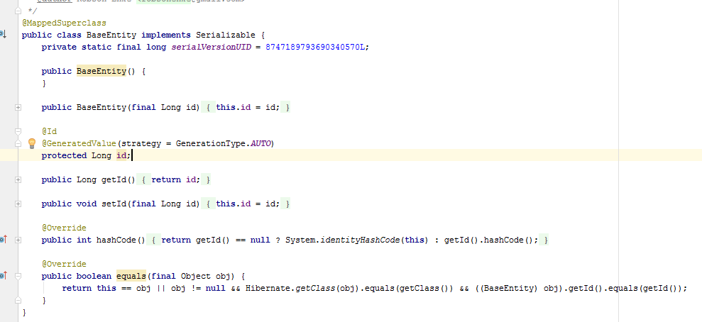
Simple Mapping
Inheritance
Notes:
Content Slide: This is usually the most frequently used slide in every presentation.
Use this slide for Text heavy slides. Text can only be used in bullet points
Title Heading – font size 30, Arial bold
Slide Content – Should not reduce beyond Arial font 16
If you need to use sub bullets please use the indent buttons located next to the bullets buttons in the tool bar and this will automatically provide you with the second, third, fourth & fifth level bullet styles and font sizes
Please note you can also press the tab key to create the different levels of bulleted content

Slide 22
Simple Mapping
Enhance Java domain classes with JPA annotations
Exercise 2
Fix the MappedSuperclass
Create a new “Course”
How many course do we have on the database?
Notes:
Content Slide: This is usually the most frequently used slide in every presentation.
Use this slide for Text heavy slides. Text can only be used in bullet points
Title Heading – font size 30, Arial bold
Slide Content – Should not reduce beyond Arial font 16
If you need to use sub bullets please use the indent buttons located next to the bullets buttons in the tool bar and this will automatically provide you with the second, third, fourth & fifth level bullet styles and font sizes
Please note you can also press the tab key to create the different levels of bulleted content

Slide 23
Entity relationships
One-to-one, one-to-many, many-to-many, many-to-one relationships among entities
bi-directional or uni-directional
Support for different Collection types, e.g., List, Set, Map, etc.
Need to specify the owning side in relationships
Owning side table has the foreign key
OneToOne relationship - the side where the foreign key is specified
OneToMany, ManyToOne - the “many” side
Notes:
Content Slide: This is usually the most frequently used slide in every presentation.
Use this slide for Text heavy slides. Text can only be used in bullet points
Title Heading – font size 30, Arial bold
Slide Content – Should not reduce beyond Arial font 16
If you need to use sub bullets please use the indent buttons located next to the bullets buttons in the tool bar and this will automatically provide you with the second, third, fourth & fifth level bullet styles and font sizes
Please note you can also press the tab key to create the different levels of bulleted content

Slide 24
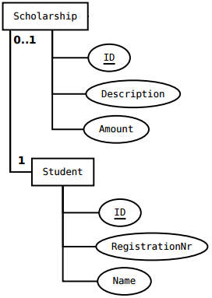
Relationship mapping
Bidirectional OneToOne
Important elements
@OneToOne | Defines a single-valued association to another entity that has one-to-one multiplicity.
FetchType | LAZY = do not load referenced entity, until it is accessed for the first time EAGER = load referenced entity immediately
CascadeType | Defines the set of cascadable operations that are propagated to the associated entity. ALL is equivalent to cascade={PERSIST, MERGE, REMOVE, REFRESH, DETACH}
Notes:
Content Slide: This is usually the most frequently used slide in every presentation.
Use this slide for Text heavy slides. Text can only be used in bullet points
Title Heading – font size 30, Arial bold
Slide Content – Should not reduce beyond Arial font 16
If you need to use sub bullets please use the indent buttons located next to the bullets buttons in the tool bar and this will automatically provide you with the second, third, fourth & fifth level bullet styles and font sizes
Please note you can also press the tab key to create the different levels of bulleted content

Slide 25
Relationship mapping
Bidirectional OneToOne
Important elements
mappedBy | References the field that “owns” the relationship in the referenced entity. Required unless the relationship is unidirectional.
@JoinColumn | Specifies a column for joining an entity association or element collection. In this case: the name of the column, where the foreign key will be stored.
Notes:
Content Slide: This is usually the most frequently used slide in every presentation.
Use this slide for Text heavy slides. Text can only be used in bullet points
Title Heading – font size 30, Arial bold
Slide Content – Should not reduce beyond Arial font 16
If you need to use sub bullets please use the indent buttons located next to the bullets buttons in the tool bar and this will automatically provide you with the second, third, fourth & fifth level bullet styles and font sizes
Please note you can also press the tab key to create the different levels of bulleted content

Slide 26

Relationship mapping
Bidirectional OneToOne
Notes:
Content Slide: This is usually the most frequently used slide in every presentation.
Use this slide for Text heavy slides. Text can only be used in bullet points
Title Heading – font size 30, Arial bold
Slide Content – Should not reduce beyond Arial font 16
If you need to use sub bullets please use the indent buttons located next to the bullets buttons in the tool bar and this will automatically provide you with the second, third, fourth & fifth level bullet styles and font sizes
Please note you can also press the tab key to create the different levels of bulleted content

Slide 27
Simple Mapping
Enhance Java domain classes with JPA annotations
Exercise 3
Map the classes Student and Scholarship
Create a new student with scholarship
How many students/scholarship do we have on the datababse?
Notes:
Content Slide: This is usually the most frequently used slide in every presentation.
Use this slide for Text heavy slides. Text can only be used in bullet points
Title Heading – font size 30, Arial bold
Slide Content – Should not reduce beyond Arial font 16
If you need to use sub bullets please use the indent buttons located next to the bullets buttons in the tool bar and this will automatically provide you with the second, third, fourth & fifth level bullet styles and font sizes
Please note you can also press the tab key to create the different levels of bulleted content

Slide 28
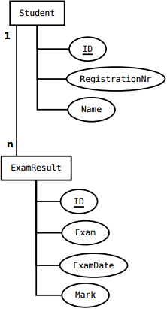
Entity Relationship vs. Object Oriented
ER: ExamResult contains a foreign key to the Student it belongs to
The ExamResult owns (contains) the connection
This is opposite to the OO perspective
OO: Student owns the ExamResults
No ExamResult without a student
Notes:
Content Slide: This is usually the most frequently used slide in every presentation.
Use this slide for Text heavy slides. Text can only be used in bullet points
Title Heading – font size 30, Arial bold
Slide Content – Should not reduce beyond Arial font 16
If you need to use sub bullets please use the indent buttons located next to the bullets buttons in the tool bar and this will automatically provide you with the second, third, fourth & fifth level bullet styles and font sizes
Please note you can also press the tab key to create the different levels of bulleted content

Slide 29
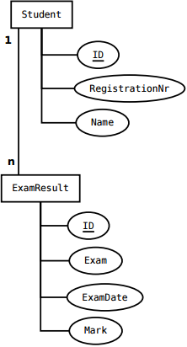
Relationship mapping
Bidirectional OneToMany
Important elements
@OneToMany | Defines a many-valued association with one-to-many multiplicity
@ManyToOne | Defines a single-valued association to another entity class that has many-to-one multiplicity.
Notes:
Content Slide: This is usually the most frequently used slide in every presentation.
Use this slide for Text heavy slides. Text can only be used in bullet points
Title Heading – font size 30, Arial bold
Slide Content – Should not reduce beyond Arial font 16
If you need to use sub bullets please use the indent buttons located next to the bullets buttons in the tool bar and this will automatically provide you with the second, third, fourth & fifth level bullet styles and font sizes
Please note you can also press the tab key to create the different levels of bulleted content

Slide 30


Relationship mapping
Bidirectional OneToMany
Notes:
Content Slide: This is usually the most frequently used slide in every presentation.
Use this slide for Text heavy slides. Text can only be used in bullet points
Title Heading – font size 30, Arial bold
Slide Content – Should not reduce beyond Arial font 16
If you need to use sub bullets please use the indent buttons located next to the bullets buttons in the tool bar and this will automatically provide you with the second, third, fourth & fifth level bullet styles and font sizes
Please note you can also press the tab key to create the different levels of bulleted content

Slide 31
Simple Mapping
Enhance Java domain classes with JPA annotations
Exercise 4
Map the classes Student and ExamResult
Create a new student with, at least, two exams
How many exams each students have on the database?
Notes:
Content Slide: This is usually the most frequently used slide in every presentation.
Use this slide for Text heavy slides. Text can only be used in bullet points
Title Heading – font size 30, Arial bold
Slide Content – Should not reduce beyond Arial font 16
If you need to use sub bullets please use the indent buttons located next to the bullets buttons in the tool bar and this will automatically provide you with the second, third, fourth & fifth level bullet styles and font sizes
Please note you can also press the tab key to create the different levels of bulleted content

Slide 32
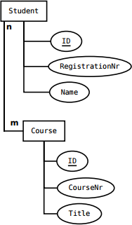
Relationship mapping
Bidirectional ManyToMany
Important elements
@ManyToMany | Defines a many valued association with many-to-many multiplicity.
mappedBy | Defines who owns the relation.
Notes:
Content Slide: This is usually the most frequently used slide in every presentation.
Use this slide for Text heavy slides. Text can only be used in bullet points
Title Heading – font size 30, Arial bold
Slide Content – Should not reduce beyond Arial font 16
If you need to use sub bullets please use the indent buttons located next to the bullets buttons in the tool bar and this will automatically provide you with the second, third, fourth & fifth level bullet styles and font sizes
Please note you can also press the tab key to create the different levels of bulleted content

Slide 33


Relationship mapping
Bidirectional ManyToMany
Notes:
Content Slide: This is usually the most frequently used slide in every presentation.
Use this slide for Text heavy slides. Text can only be used in bullet points
Title Heading – font size 30, Arial bold
Slide Content – Should not reduce beyond Arial font 16
If you need to use sub bullets please use the indent buttons located next to the bullets buttons in the tool bar and this will automatically provide you with the second, third, fourth & fifth level bullet styles and font sizes
Please note you can also press the tab key to create the different levels of bulleted content

Slide 34
Simple Mapping
Enhance Java domain classes with JPA annotations
Exercise 5
Map the classes Course and Student
Find the course ID 1
Find all the students
Set the list of students into the course ID 1
Notes:
Content Slide: This is usually the most frequently used slide in every presentation.
Use this slide for Text heavy slides. Text can only be used in bullet points
Title Heading – font size 30, Arial bold
Slide Content – Should not reduce beyond Arial font 16
If you need to use sub bullets please use the indent buttons located next to the bullets buttons in the tool bar and this will automatically provide you with the second, third, fourth & fifth level bullet styles and font sizes
Please note you can also press the tab key to create the different levels of bulleted content

Slide 35
Cascade and Fetch
How to manage the dependencies
Cascade Types
All four relationship annotations may specify operations cascaded to associated entities
ALL, PERSIST, MERGE, REMOVE, REFRESH, DETACH
Default is none
Fetching Strategies
Define how object hierarchies are loaded
EAGER = load all related objects immediately
LAZY = load the related objects only if they are accessed for the first time
Be careful with EAGER, as large object graphs may be loaded unintentionally!
Notes:
Content Slide: This is usually the most frequently used slide in every presentation.
Use this slide for Text heavy slides. Text can only be used in bullet points
Title Heading – font size 30, Arial bold
Slide Content – Should not reduce beyond Arial font 16
If you need to use sub bullets please use the indent buttons located next to the bullets buttons in the tool bar and this will automatically provide you with the second, third, fourth & fifth level bullet styles and font sizes
Please note you can also press the tab key to create the different levels of bulleted content

Slide 36
Simple Mapping
Enhance Java domain classes with JPA annotations
Exercise 6
Check the console output
Differences between LAZY and EAGER
Change the fetch property of the @ManyToMany (Course.java)
Find the course ID 1 and check on the output console
Invoke the getStudents() of the course object and check on the output console once again
Notes:
Content Slide: This is usually the most frequently used slide in every presentation.
Use this slide for Text heavy slides. Text can only be used in bullet points
Title Heading – font size 30, Arial bold
Slide Content – Should not reduce beyond Arial font 16
If you need to use sub bullets please use the indent buttons located next to the bullets buttons in the tool bar and this will automatically provide you with the second, third, fourth & fifth level bullet styles and font sizes
Please note you can also press the tab key to create the different levels of bulleted content

Slide 37
Simple Mapping
Enhance Java domain classes with JPA annotations
Exercise 7 (check the difference between the cascades types)
Create a new student with a scholarship.
Remove the cascade type of the Student.java (line 43) and re-run the main method.
How to fix it?
Notes:
Content Slide: This is usually the most frequently used slide in every presentation.
Use this slide for Text heavy slides. Text can only be used in bullet points
Title Heading – font size 30, Arial bold
Slide Content – Should not reduce beyond Arial font 16
If you need to use sub bullets please use the indent buttons located next to the bullets buttons in the tool bar and this will automatically provide you with the second, third, fourth & fifth level bullet styles and font sizes
Please note you can also press the tab key to create the different levels of bulleted content

Slide 38
Persistence Concepts
Persistence Unit (PU)
Defines a set of entity classes managed by the EntityManager instance in an application
Maps the set of entity classes to a relational database
Entity Manager (EM)
API for interaction with the persistence context
Manipulates and controls the lifecycle of a persistence context
Creates and removes persistent entity instances
Finds entities using primary keys
Runs queries on entities
Session
Notes:
Content Slide: This is usually the most frequently used slide in every presentation.
Use this slide for Text heavy slides. Text can only be used in bullet points
Title Heading – font size 30, Arial bold
Slide Content – Should not reduce beyond Arial font 16
If you need to use sub bullets please use the indent buttons located next to the bullets buttons in the tool bar and this will automatically provide you with the second, third, fourth & fifth level bullet styles and font sizes
Please note you can also press the tab key to create the different levels of bulleted content

Slide 39
Persistence Unit
Persistence Unit
Configuration to map entity classes in an application to a relational database
persistence.xml defines one or more persistence units
Defined under /conf/META-INF/persistence.xml
Classes with JPA annotations are automatically detected upon start of the application
Notes:
Content Slide: This is usually the most frequently used slide in every presentation.
Use this slide for Text heavy slides. Text can only be used in bullet points
Title Heading – font size 30, Arial bold
Slide Content – Should not reduce beyond Arial font 16
If you need to use sub bullets please use the indent buttons located next to the bullets buttons in the tool bar and this will automatically provide you with the second, third, fourth & fifth level bullet styles and font sizes
Please note you can also press the tab key to create the different levels of bulleted content

Slide 40
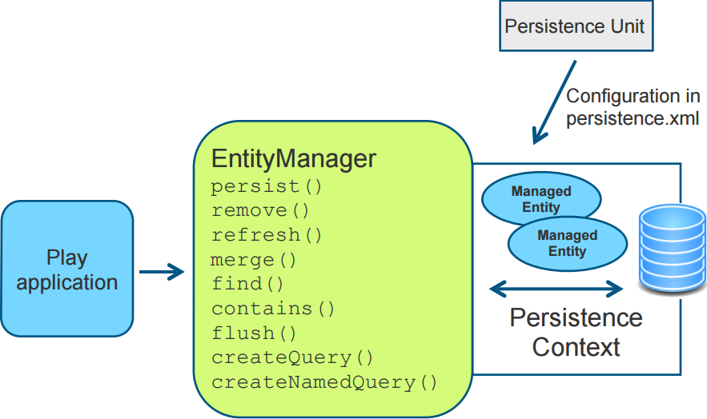
Entity Manager
Notes:
Content Slide: This is usually the most frequently used slide in every presentation.
Use this slide for Text heavy slides. Text can only be used in bullet points
Title Heading – font size 30, Arial bold
Slide Content – Should not reduce beyond Arial font 16
If you need to use sub bullets please use the indent buttons located next to the bullets buttons in the tool bar and this will automatically provide you with the second, third, fourth & fifth level bullet styles and font sizes
Please note you can also press the tab key to create the different levels of bulleted content

Slide 41
Entity manager operations
Main operations
persist() | Make an entity instance managed and persistent. Throws EntityExistsException, if the entity instance already exists.
merge() | Make an entity instance managed and persistent. If it does not exist yet, persist it. If it already exists, the entity instance is updated.
find() | Find the entity instance using the primary key.
remove() | Remove the instance from the persistence context.
Notes:
Content Slide: This is usually the most frequently used slide in every presentation.
Use this slide for Text heavy slides. Text can only be used in bullet points
Title Heading – font size 30, Arial bold
Slide Content – Should not reduce beyond Arial font 16
If you need to use sub bullets please use the indent buttons located next to the bullets buttons in the tool bar and this will automatically provide you with the second, third, fourth & fifth level bullet styles and font sizes
Please note you can also press the tab key to create the different levels of bulleted content

Slide 42
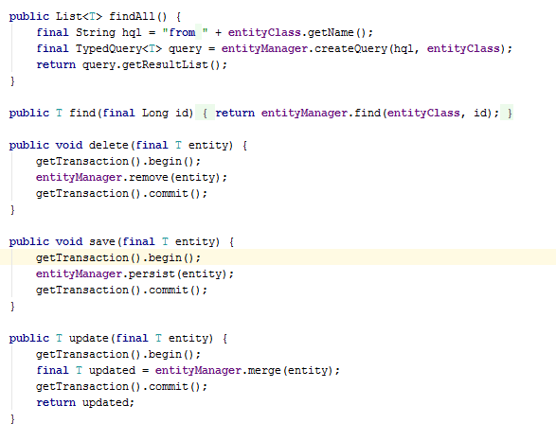
Entity manager operations
Notes:
Content Slide: This is usually the most frequently used slide in every presentation.
Use this slide for Text heavy slides. Text can only be used in bullet points
Title Heading – font size 30, Arial bold
Slide Content – Should not reduce beyond Arial font 16
If you need to use sub bullets please use the indent buttons located next to the bullets buttons in the tool bar and this will automatically provide you with the second, third, fourth & fifth level bullet styles and font sizes
Please note you can also press the tab key to create the different levels of bulleted content

Slide 43
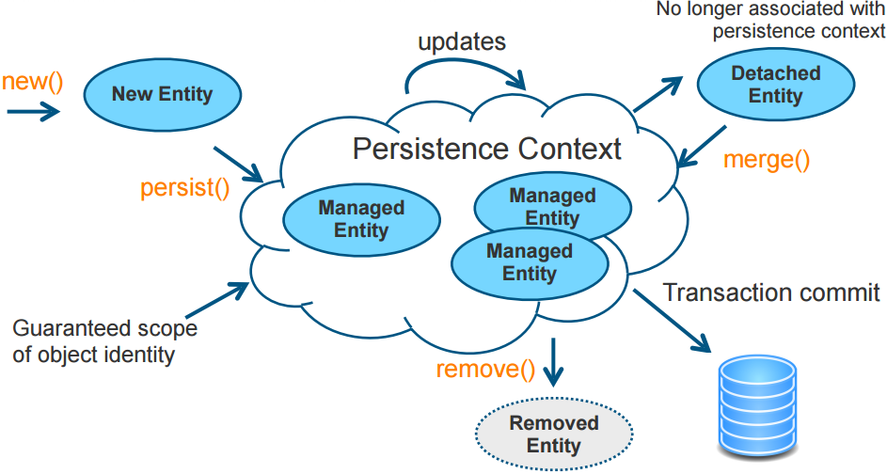
Persistence Context
Notes:
Content Slide: This is usually the most frequently used slide in every presentation.
Use this slide for Text heavy slides. Text can only be used in bullet points
Title Heading – font size 30, Arial bold
Slide Content – Should not reduce beyond Arial font 16
If you need to use sub bullets please use the indent buttons located next to the bullets buttons in the tool bar and this will automatically provide you with the second, third, fourth & fifth level bullet styles and font sizes
Please note you can also press the tab key to create the different levels of bulleted content

Slide 44
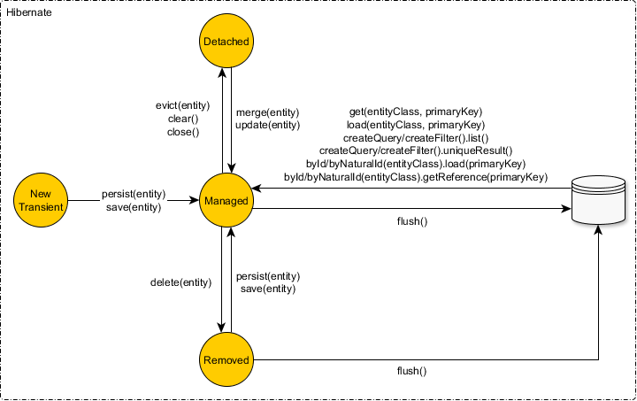
Persistence Context
Notes:
Content Slide: This is usually the most frequently used slide in every presentation.
Use this slide for Text heavy slides. Text can only be used in bullet points
Title Heading – font size 30, Arial bold
Slide Content – Should not reduce beyond Arial font 16
If you need to use sub bullets please use the indent buttons located next to the bullets buttons in the tool bar and this will automatically provide you with the second, third, fourth & fifth level bullet styles and font sizes
Please note you can also press the tab key to create the different levels of bulleted content

Slide 45
Simple Mapping
Enhance Java domain classes with JPA annotations
Exercise 8
JPA object cycle
Notes:
Content Slide: This is usually the most frequently used slide in every presentation.
Use this slide for Text heavy slides. Text can only be used in bullet points
Title Heading – font size 30, Arial bold
Slide Content – Should not reduce beyond Arial font 16
If you need to use sub bullets please use the indent buttons located next to the bullets buttons in the tool bar and this will automatically provide you with the second, third, fourth & fifth level bullet styles and font sizes
Please note you can also press the tab key to create the different levels of bulleted content

Slide 46
Finding Entities
Find entity by primary key using EntityManager
For complex queries use
Java Persistence Query Language (JPQL) or Hibernate Query Language (HQL)
Both are object model focused query languages similar in nature to SQL. JPQL is a heavily-inspired-by subset of HQL. A JPQL query is always a valid HQL query, the reverse is not true however.
Criteria API
Native Queries
EntityManager provides methods for creating Query objects
createQuery
createNativeQuery (using plain SQL - not recommended)
Notes:
Content Slide: This is usually the most frequently used slide in every presentation.
Use this slide for Text heavy slides. Text can only be used in bullet points
Title Heading – font size 30, Arial bold
Slide Content – Should not reduce beyond Arial font 16
If you need to use sub bullets please use the indent buttons located next to the bullets buttons in the tool bar and this will automatically provide you with the second, third, fourth & fifth level bullet styles and font sizes
Please note you can also press the tab key to create the different levels of bulleted content

Slide 47
JPQL/HQL
Similar to SQL
Works with entities as defined in the application and not with SQL table names and attribute names
Portable (they abstract from vendor-specific SQL)
Returns entities (no need to worry about result sets and their manual conversion to POJOs)
Select, update, delete
Support for:
Joins
Conditional Expressions
Functional Expressions
Subqueries
Order by, group by, having
Notes:
Content Slide: This is usually the most frequently used slide in every presentation.
Use this slide for Text heavy slides. Text can only be used in bullet points
Title Heading – font size 30, Arial bold
Slide Content – Should not reduce beyond Arial font 16
If you need to use sub bullets please use the indent buttons located next to the bullets buttons in the tool bar and this will automatically provide you with the second, third, fourth & fifth level bullet styles and font sizes
Please note you can also press the tab key to create the different levels of bulleted content

Slide 48
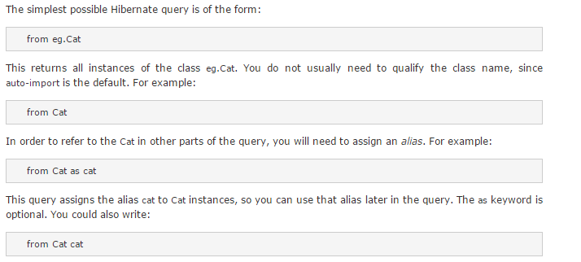
HQL
Notes:
Content Slide: This is usually the most frequently used slide in every presentation.
Use this slide for Text heavy slides. Text can only be used in bullet points
Title Heading – font size 30, Arial bold
Slide Content – Should not reduce beyond Arial font 16
If you need to use sub bullets please use the indent buttons located next to the bullets buttons in the tool bar and this will automatically provide you with the second, third, fourth & fifth level bullet styles and font sizes
Please note you can also press the tab key to create the different levels of bulleted content

Slide 49
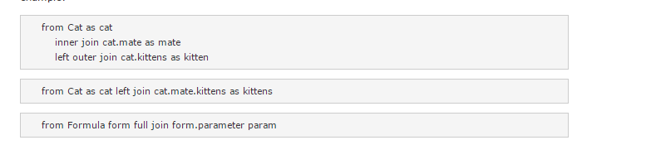

HQL
Notes:
Content Slide: This is usually the most frequently used slide in every presentation.
Use this slide for Text heavy slides. Text can only be used in bullet points
Title Heading – font size 30, Arial bold
Slide Content – Should not reduce beyond Arial font 16
If you need to use sub bullets please use the indent buttons located next to the bullets buttons in the tool bar and this will automatically provide you with the second, third, fourth & fifth level bullet styles and font sizes
Please note you can also press the tab key to create the different levels of bulleted content

Slide 50
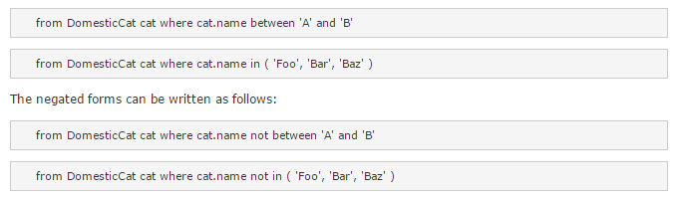
HQL
Notes:
Content Slide: This is usually the most frequently used slide in every presentation.
Use this slide for Text heavy slides. Text can only be used in bullet points
Title Heading – font size 30, Arial bold
Slide Content – Should not reduce beyond Arial font 16
If you need to use sub bullets please use the indent buttons located next to the bullets buttons in the tool bar and this will automatically provide you with the second, third, fourth & fifth level bullet styles and font sizes
Please note you can also press the tab key to create the different levels of bulleted content

Slide 51
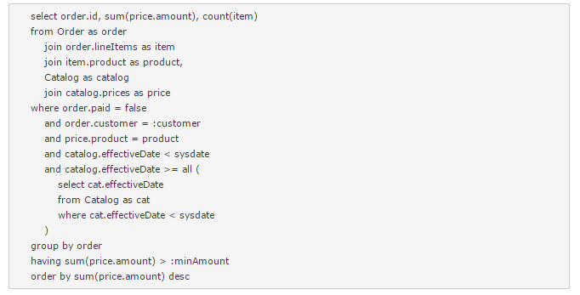
HQL
Notes:
Content Slide: This is usually the most frequently used slide in every presentation.
Use this slide for Text heavy slides. Text can only be used in bullet points
Title Heading – font size 30, Arial bold
Slide Content – Should not reduce beyond Arial font 16
If you need to use sub bullets please use the indent buttons located next to the bullets buttons in the tool bar and this will automatically provide you with the second, third, fourth & fifth level bullet styles and font sizes
Please note you can also press the tab key to create the different levels of bulleted content

Slide 52
Querying Entities with JPQL
Dynamic Query
Use parameter substitution and do not concatenate the JPQL string with the parameter values
Static Query
Named Query
Recommended, as it may leverage use of query cache
Notes:
Content Slide: This is usually the most frequently used slide in every presentation.
Use this slide for Text heavy slides. Text can only be used in bullet points
Title Heading – font size 30, Arial bold
Slide Content – Should not reduce beyond Arial font 16
If you need to use sub bullets please use the indent buttons located next to the bullets buttons in the tool bar and this will automatically provide you with the second, third, fourth & fifth level bullet styles and font sizes
Please note you can also press the tab key to create the different levels of bulleted content

Slide 53
Wrap up
Lessons learned today
JPA/Hibernate provide a powerful ORM feature for Java-based applications
Lot’s of magic happens under the hood - know the data engineering basics first!
Before putting your persistence layer into production, thoroughly test it using unit test
Notes:
Content Slide: This is usually the most frequently used slide in every presentation.
Use this slide for Text heavy slides. Text can only be used in bullet points
Title Heading – font size 30, Arial bold
Slide Content – Should not reduce beyond Arial font 16
If you need to use sub bullets please use the indent buttons located next to the bullets buttons in the tool bar and this will automatically provide you with the second, third, fourth & fifth level bullet styles and font sizes
Please note you can also press the tab key to create the different levels of bulleted content

Slide 54
Good Practices
Making your life easier with Hibernate
Always implement consistently the equals and hashcode methods;
Make sure not to manually set an ID of an entity;
Make sure not to manually set a collection instance;
If possible, always use simple primary keys;
A method returning a collection should never return null.
Notes:
Content Slide: This is usually the most frequently used slide in every presentation.
Use this slide for Text heavy slides. Text can only be used in bullet points
Title Heading – font size 30, Arial bold
Slide Content – Should not reduce beyond Arial font 16
If you need to use sub bullets please use the indent buttons located next to the bullets buttons in the tool bar and this will automatically provide you with the second, third, fourth & fifth level bullet styles and font sizes
Please note you can also press the tab key to create the different levels of bulleted content

Slide 55
Thank you
Notes:
Thank you slide with the customer logo:
Should have only the details shown here. Logo placement cannot be changed. Wipro logo to appear on the left as per our corporate guidelines.
Thank you– font size 30, Arial Bold
Name & Designation – font size 18, Arial normal, not to exceed beyond 2 lines
Your/contact email id – font size 18, Arial normal

